Slide 1
Portfolio Review
Elnaz Doostdar
Sr.UX/UI Designer

Slide 2
Agenda
Project Planner
Reporting Dashboard
Notes:
How ambitious we can be about the project?
Firm technical decisions.

Slide 3
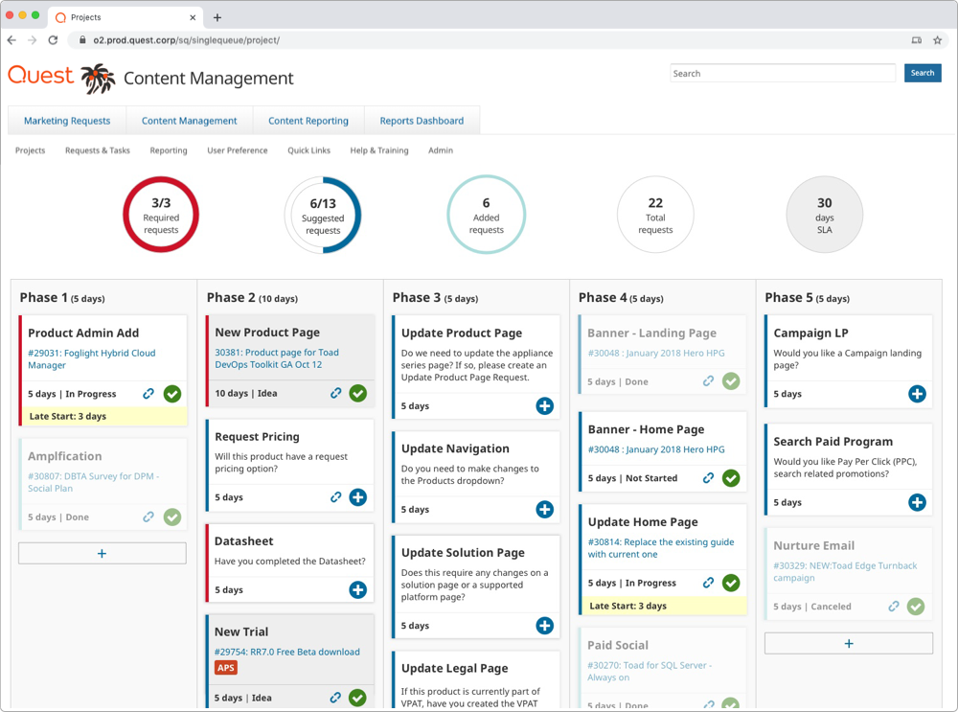
Project Planner & Reporting

Slide 4


Project Details
My role was to involve in all activities,
end-to-end, from synthesizing research results, to creating final design deliverables, and user testing.
Team
Product Manager, Product Architect,
BA, Designer,
Developers, Stakeholders
Notes:
Stakeholders
Developers
Project Manager
Business Analyst
Designer

Slide 5
Project Planner

Slide 6
Problem
Obscure body of work
Heavy manual work
Poor visibility on project status & outcome
Notes:
Challenging (tight deadlines, complex product, technical limitations, data visualization)
Oasis 2

Slide 7
Goal
Create a centralized and intuitive platform for project managers and team members to put them in control and elevate them to more meaningful work.

Slide 8
Constraints
Dependancies to other parts of a complex product
Inaccurate SLAs
Technical limitations
Migration of old projects
Notes:
How ambitious we can be about the project?
Firm technical decisions.

Slide 9
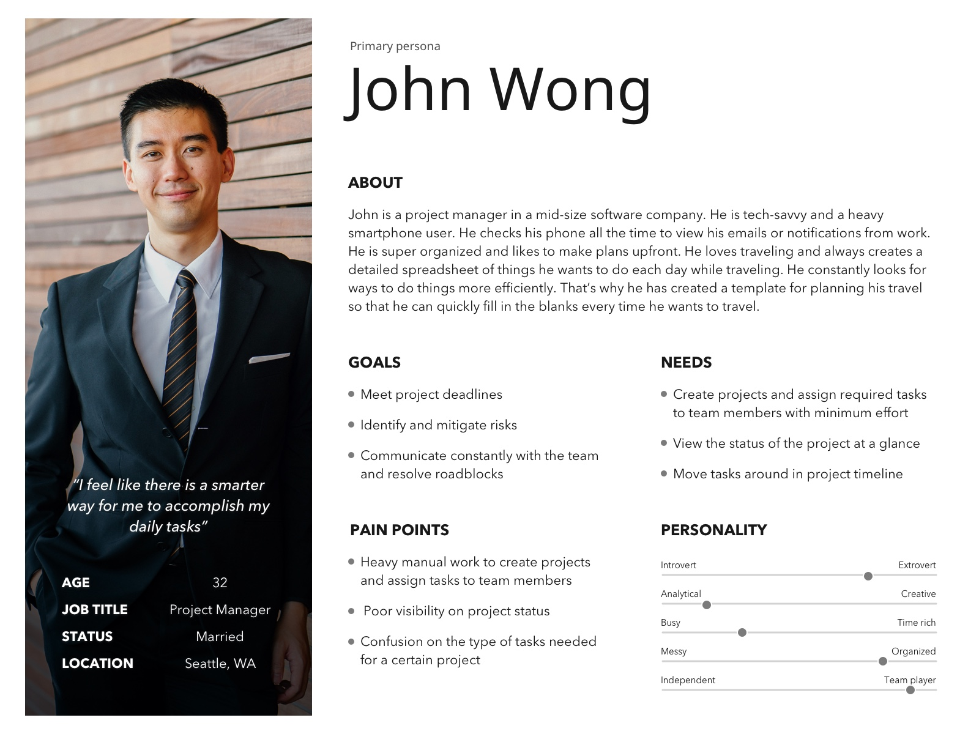
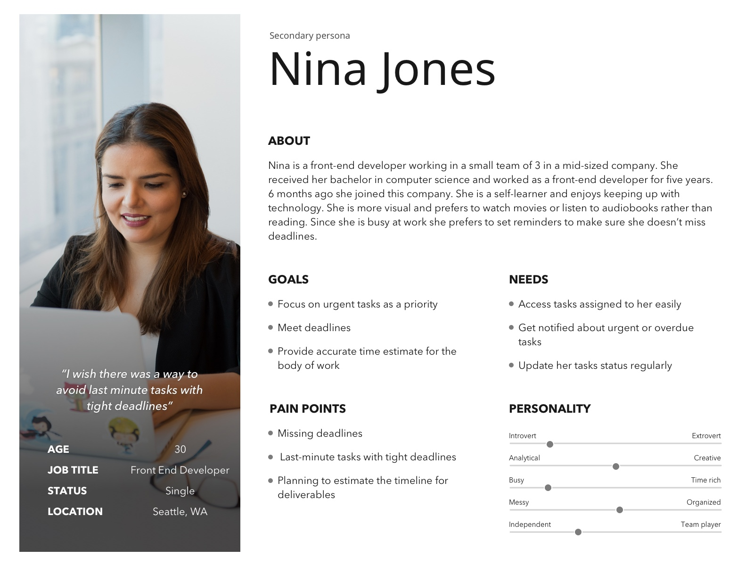
User Research
Personas
Notes:
Personas to help guide our solution

Slide 10
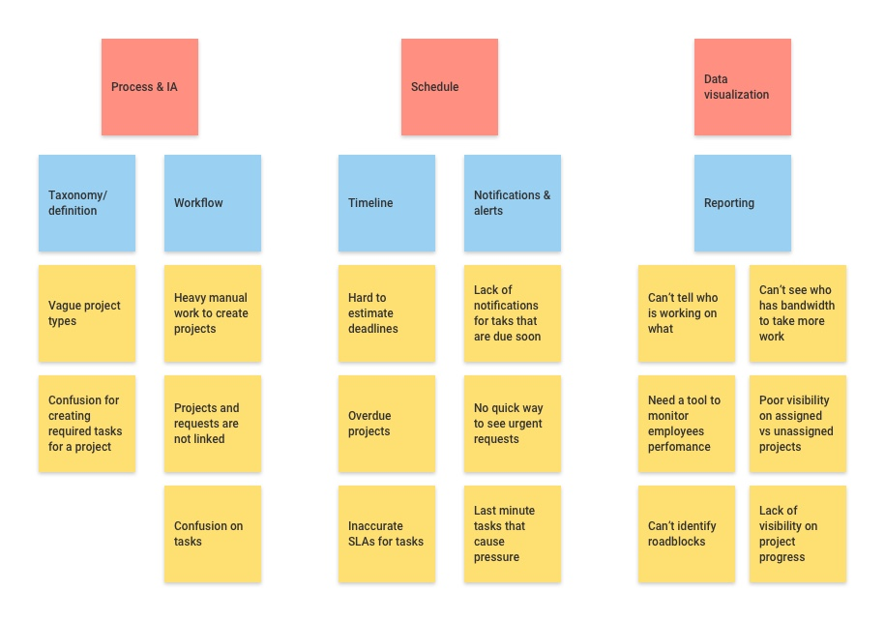
User Research
Notes:
Survey with key stakeholders to understand their roles and how the project will impact them
Contextual interviews to identify the real experience
* Categorize using affinity maps
* Create personas and journey maps
Competitive analysis to leverage available solutions

Slide 11
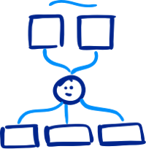
User Research
Key Insights
Last minute tasks
Shared spreadsheet of SLAs
Poor visibility on roadblocks caused delays
Bypassing current solution
Notes:
Interesting facts:
* workaround using excel sheet
* Already familiar with smartsheets and wanted something similar to that
* Surprised by the amount of time spent for doing simple tasks
* Frustration to gather information from several resources

Slide 12
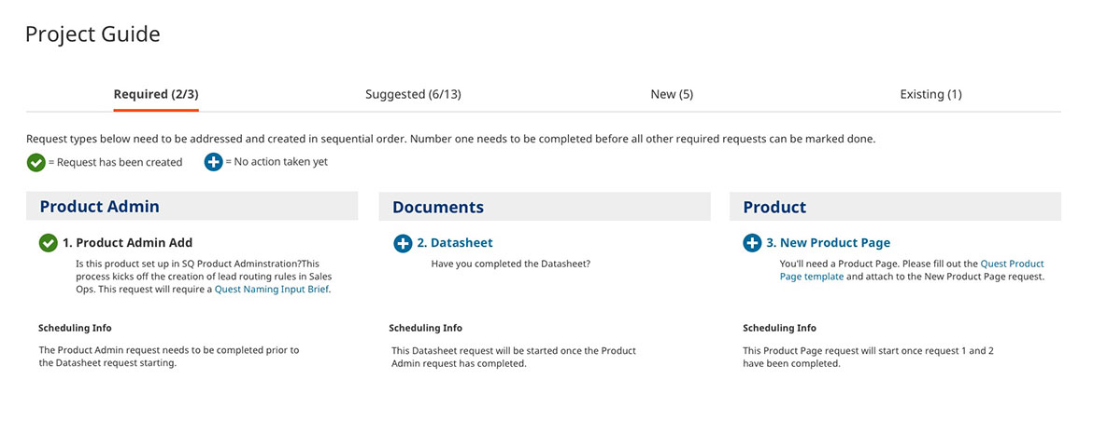
Design
Early Concept
Notes:
- Pull required tasks automatically to avoid the guess work
- Description to clarify tasks
- Walkthrough to communicate the flow

Slide 13
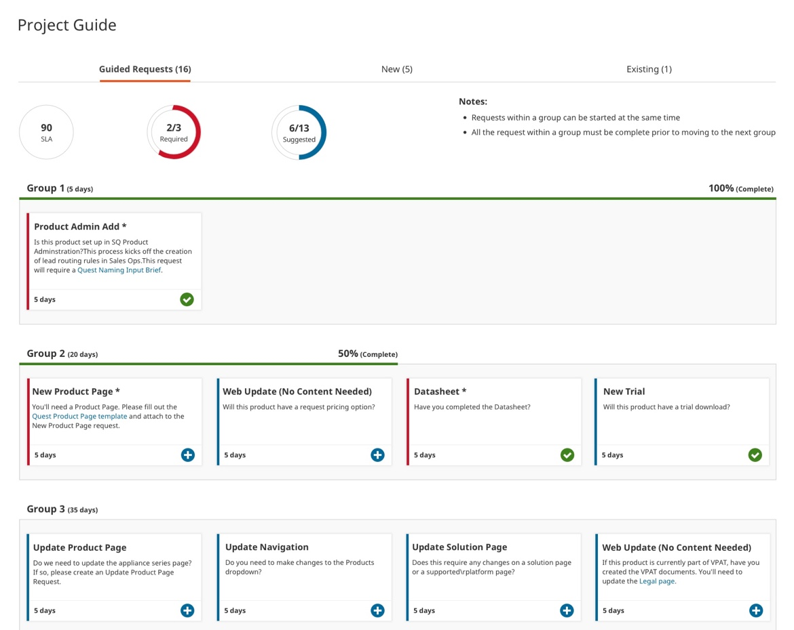
Design
Revision
Notes:
- Pull required tasks automatically to avoid the guess work
- Description to clarify tasks
- Walkthrough to communicate the flow

Slide 14
User Feedback
Key Findings
Grouping concept
Lines are confusing
Tabs adds to the cognitive load
Notes:
Aligned with smartsheets they expressed their interest in using a similar concept

Slide 15
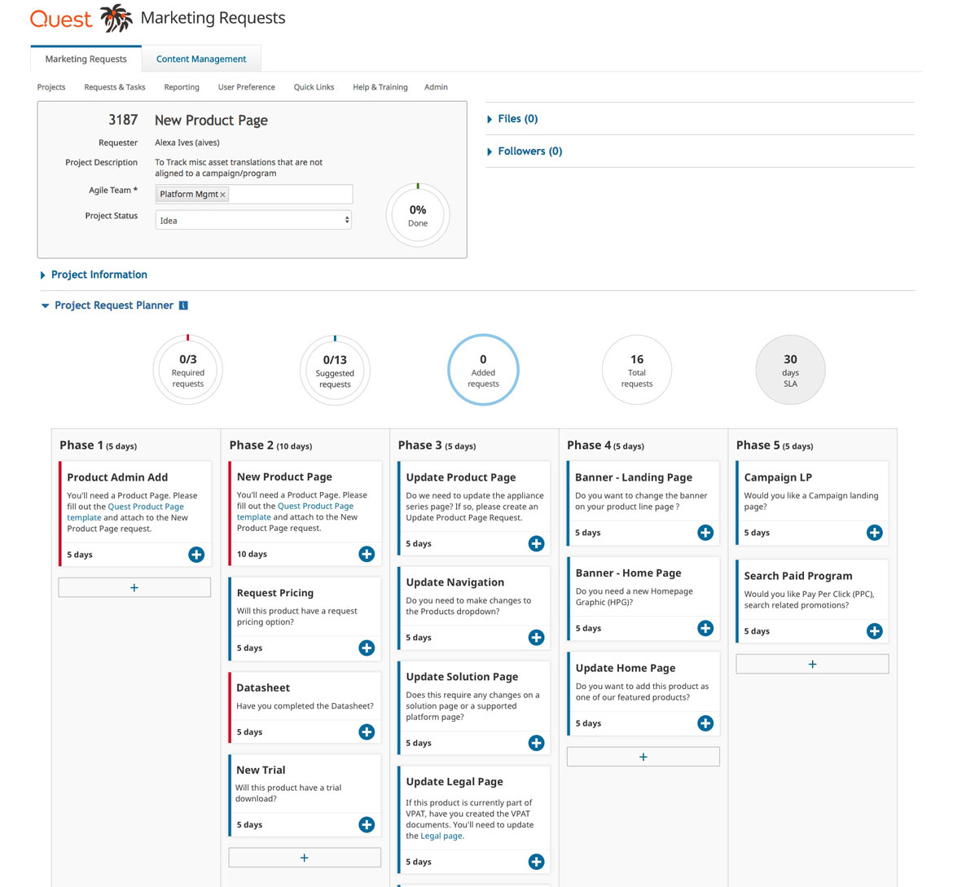
Design
Revision
Notes:
- Pull required tasks automatically to avoid the guess work
- Description to clarify tasks
- Walkthrough to communicate the flow

Slide 16
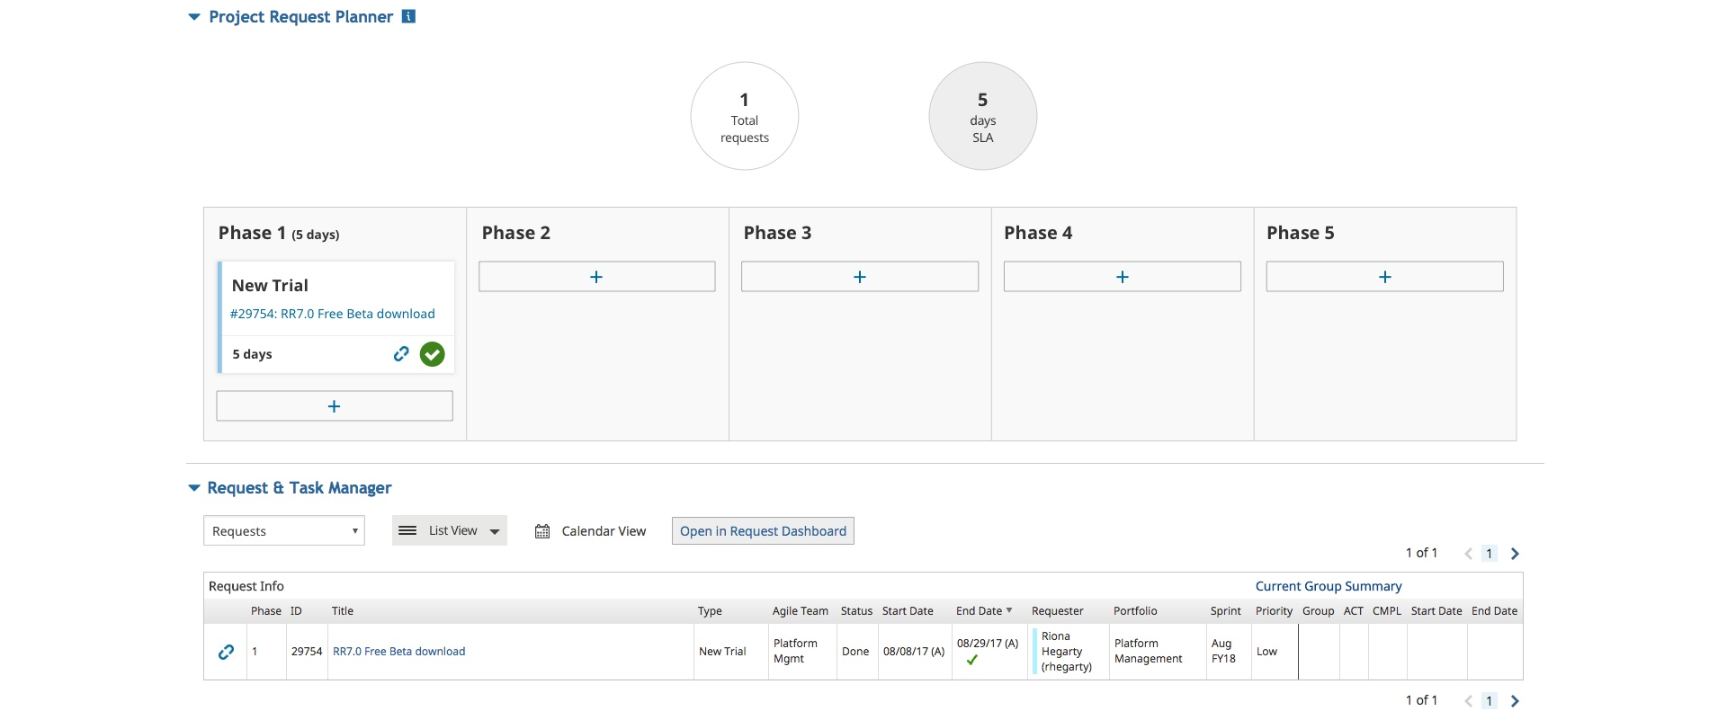
Design
Migrate Existing Projects

Slide 17
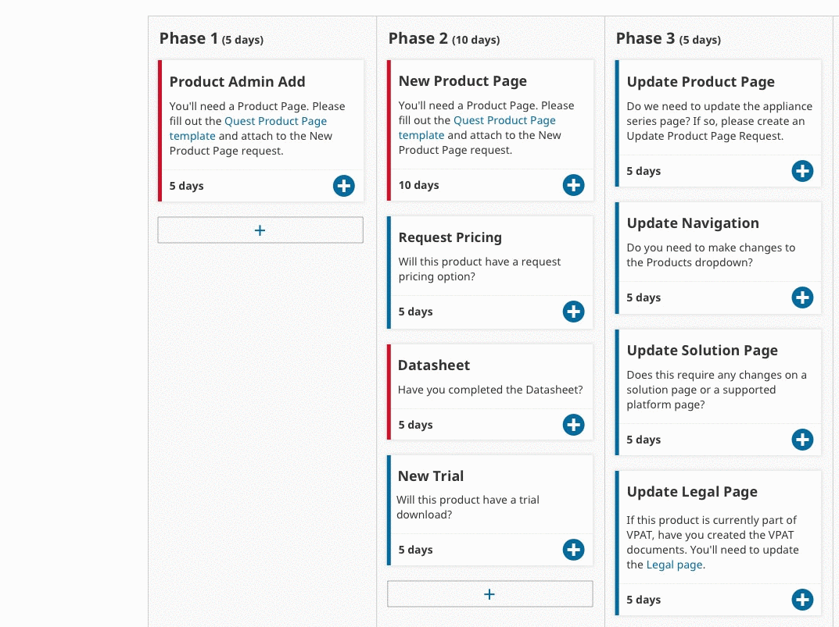
Prototype
User Flow
Notes:
The purpose of the prototype was to:
Test whether the mocks and the flow designed are helping to achieve goals
Assess whether the interactions are clear and the flow is linear
Communicate requirements with developers

Slide 18
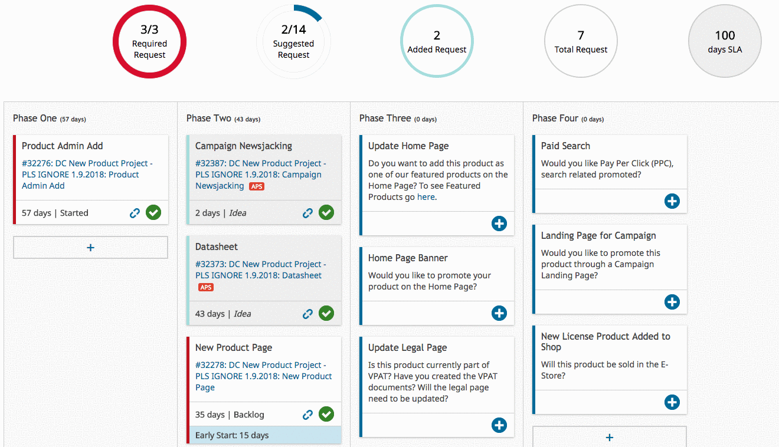
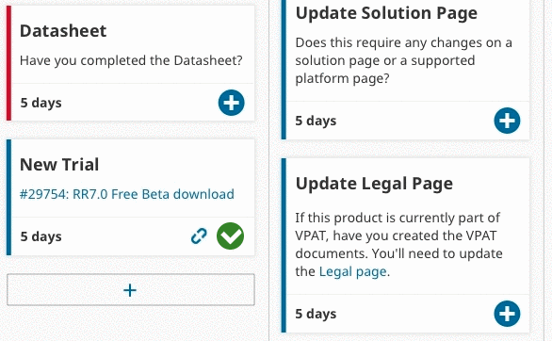
Interactions
Notes:
The purpose of the prototype was to:
Test whether the mocks and the flow designed are helping to achieve goals
Assess whether the interactions are clear and the flow is linear
Communicate requirements with developers

Slide 19
User Testing
Final Thoughts
Missing information on cards
Filters to adjust card view
Notes:
Remote usability test session
Created scenarios and tasks
Tested with 3 users

Slide 20
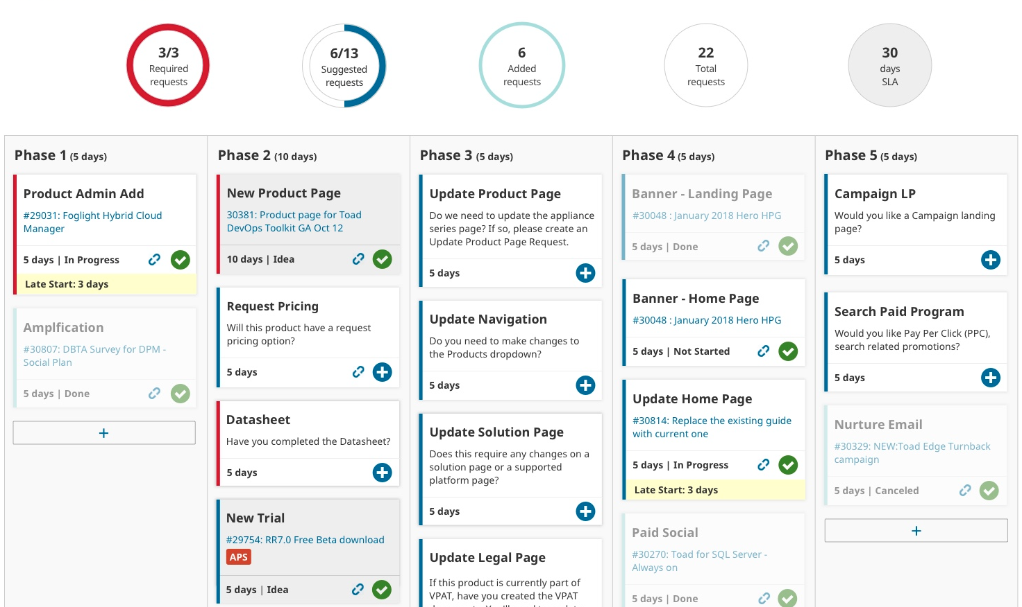
Final Design
Notes:
Technically will add 2 more weeks to the project timeline
Visually differentiate certain cards

Slide 21
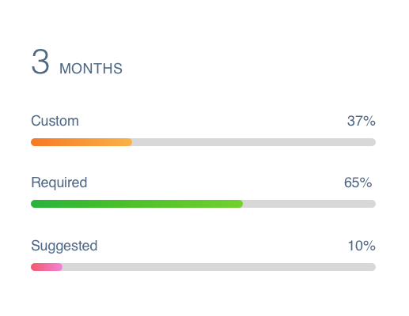
Measure Success
Time spent on creating projects
Number of delayed projects
Adoption of new features

Slide 22
Future Directions
Optimize and automate user flows further
A timer concept to track time on task
Build a reporting dashboard to analyze the outcome

Slide 23
Reporting Dashboard

Slide 24
Goal
Create a flexible and immersive data visualization dashboard for project managers and directors to gain deeper insights about:
Request management
Team performance & workload
Sprint planning
Improve SLAs

Slide 25
Challenges
Personas with different skill sets and expectations
Using the right type of chart
Technical limitations of chart types
Breaking down data to provide deeper insights
Notes:
How ambitious we can be about the project?
Firm technical decisions.

Slide 26
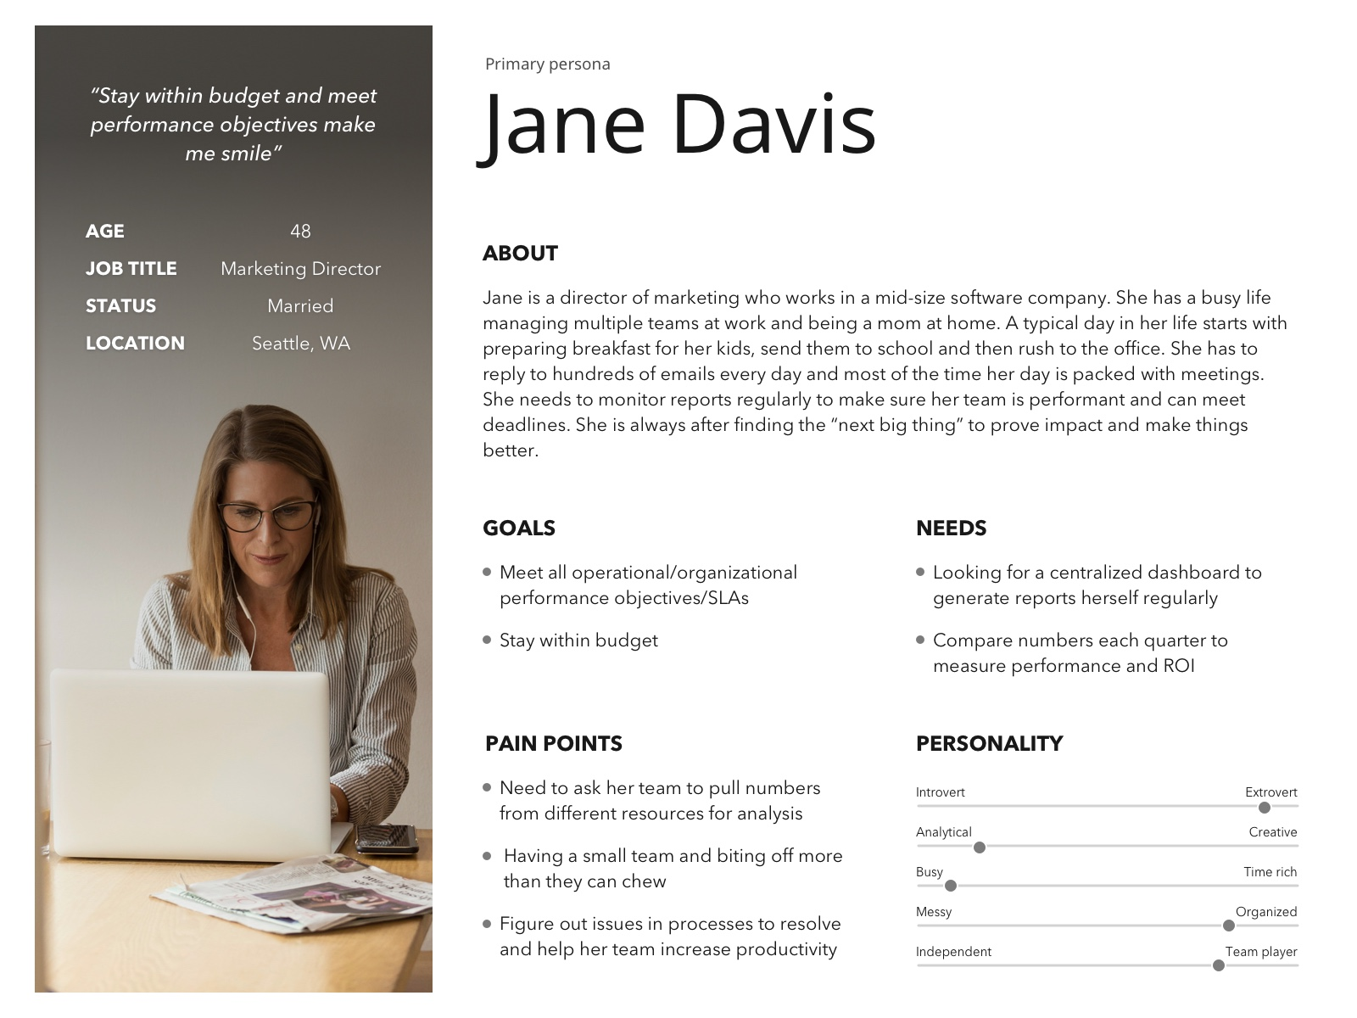
User Research
Personas
Notes:
Personas to help guide our solution

Slide 27
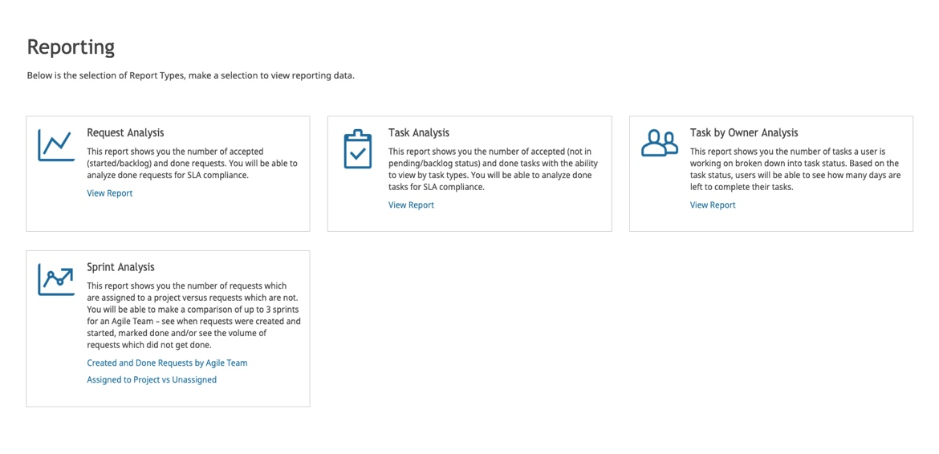
Reporting
Notes:
- Pull required tasks automatically to avoid the guess work
- Description to clarify tasks
- Walkthrough to communicate the flow

Slide 28
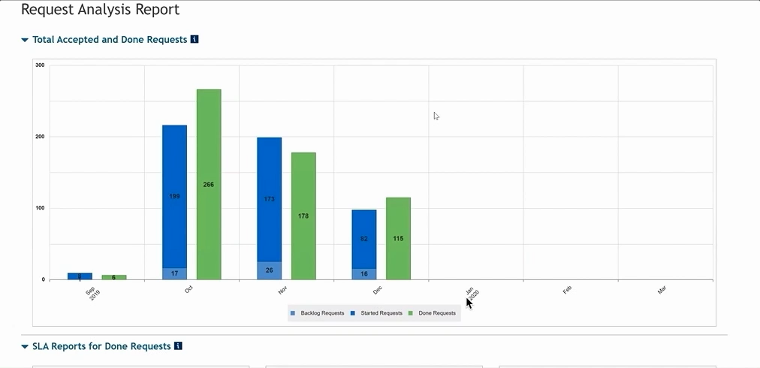
Interactions
Notes:
The purpose of the prototype was to:
Test whether the mocks and the flow designed are helping to achieve goals
Assess whether the interactions are clear and the flow is linear
Communicate requirements with developers

Slide 29
Future Directions
Saving custom filters for reports
Alerts for anomalies
NLP to reduce the learning curve for novice users
Reward team for timely projects

Slide 30
Thank You!
😊

